Slide 1
Design of a computer network BCU Iasi
Gheorghita Andrei
Student,3th year on ETTI Iasi University

Slide 2
Presentation of the project and the steps
In this project is presented the design of a computer network for the first and second floor of the Central University Library .The project is including rooms of the British Council, German Lecture room , Cafe Sage and others.
The project is created in a few steps :
-the activity resume and some details about the structure and employes
-the blueprints created in visio
-an network analysis
-an network example in Cisco
-and a File for calculations of the acquisition costs

Slide 3
The beneficiary of the network resume
Employees:
- 2 door keepers
- 1 secretary
- 1 accountant
- 2 janitors
- 2-3 managers
- 8-10 librarians
- 1 director
- System engineer
Services:
Library card
Online request
Access to the scientific databases
Reading room book request
Library's documents' copy/photocopy/scanning
Bibliographical research on request

Slide 4
SPACE SKETCH WITH DEVICE LOCATIONS

Slide 5
First floor

Slide 7
Network analysis
The subnetworks analyses
Number of the subnetworks:5
Future subnetworks : 8
Today’s subneteork will have a maximum of 30 hosts
The future subnetwork will have a number of 30 hosts
Subnetworks
Video cameras: 16
Ground floor computers: 6
Second floor computers: 18
Wi-fi routers : 4
Camera surveillance computer :1

Slide 8
Subnetwork address
The network will have a maximum of 30 hosts (computers , printers , leptops, etc) per sub-network , we cand find this by applying the formula no. of hosts = 2^{h}-2. Having 5 sub-nets, we can find that we have 3 S bits, this allows us to have at most 8 sub-nets in the future (no. of subnets = 2^{s}).
We need a C class network 215.82.46.0
2^S>=6 -> S=3
2^H-2>=25 -> H=5

Slide 9
Subnetwork mask
Subnetwork adress: 215.82.46.0 – C class
Subnetwork mask: 255.255.255.224/27 (24+3)
Binary: 11111111.11111111.11111111.11100000
CDIR : 27

Slide 10
THE SIMULATION SKETCH

Slide 11
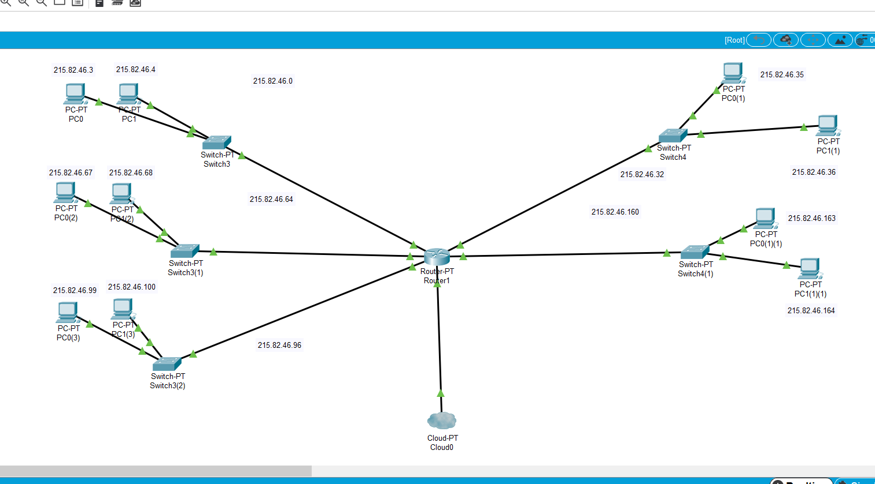

Slide 12
LIST OF NECESSARY MATERIALS AND EQUIPMENT
Routers
Ethernet Switches
Computers
Printers
Server system
Patch Panels
Rack
Copper Straight-Through Cable
Sockets
Clippers

Slide 13
Aproximation of the costs
Total cost of the material Costs | 10.496RON
Employees Salaries | 7873 RON
Logistical Costs | 1183 RON
Total Cost of the project | 19.552 RON

Slide 14
Bibliography
Emag
Wikipedia
Youtube

